Slide 1


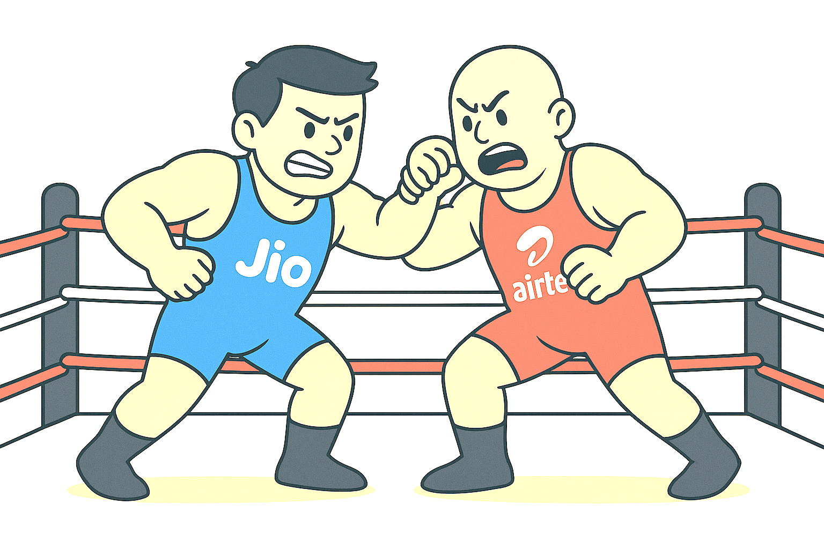
Decoding the Duopoly in Indian Telecom
Subtitle - Airtel vs Jio(with churn analysis)
NAME-ARPITA SINGH

Slide 2
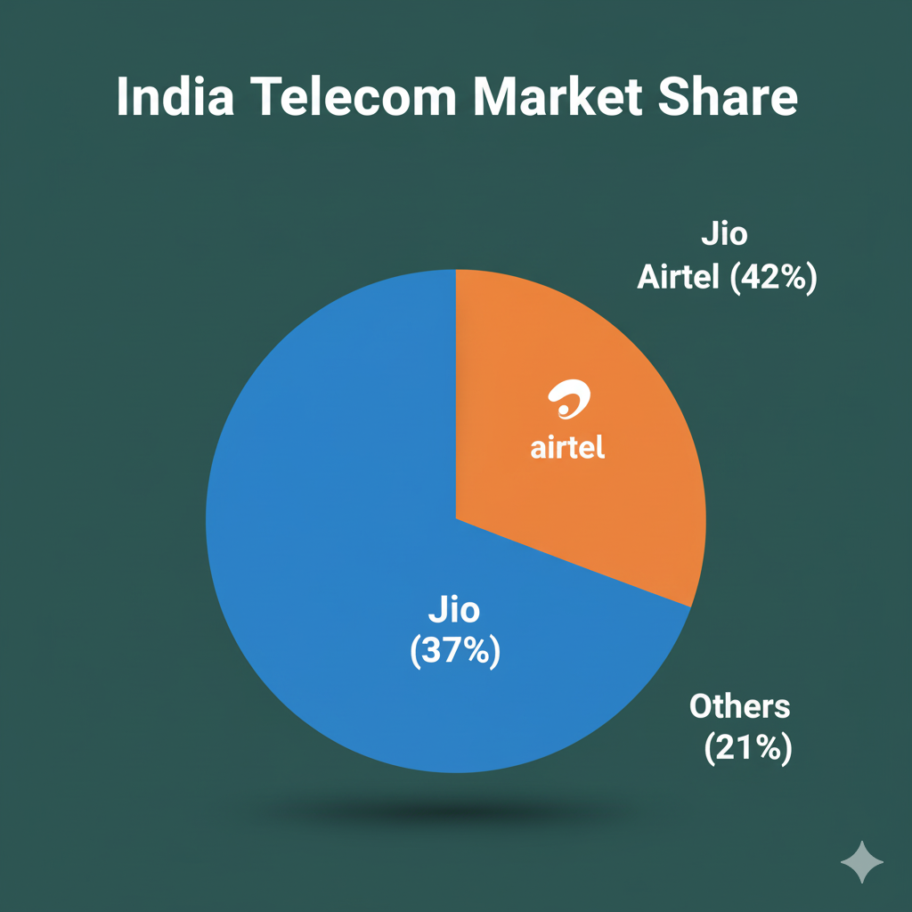
Introduction
India is the second-largest telecom market globally
(~1.18 billion connections).
Since Vodafone Idea’s decline, the market is effectively
a duopoly: Jio + Airtel.
Objective: Compare subscribers, 5G adoption,
ARPU, data usage, growth strategies.
Visual: Pie chart of market share
(Jio ~42%, Airtel ~37%, others rest).

Slide 3
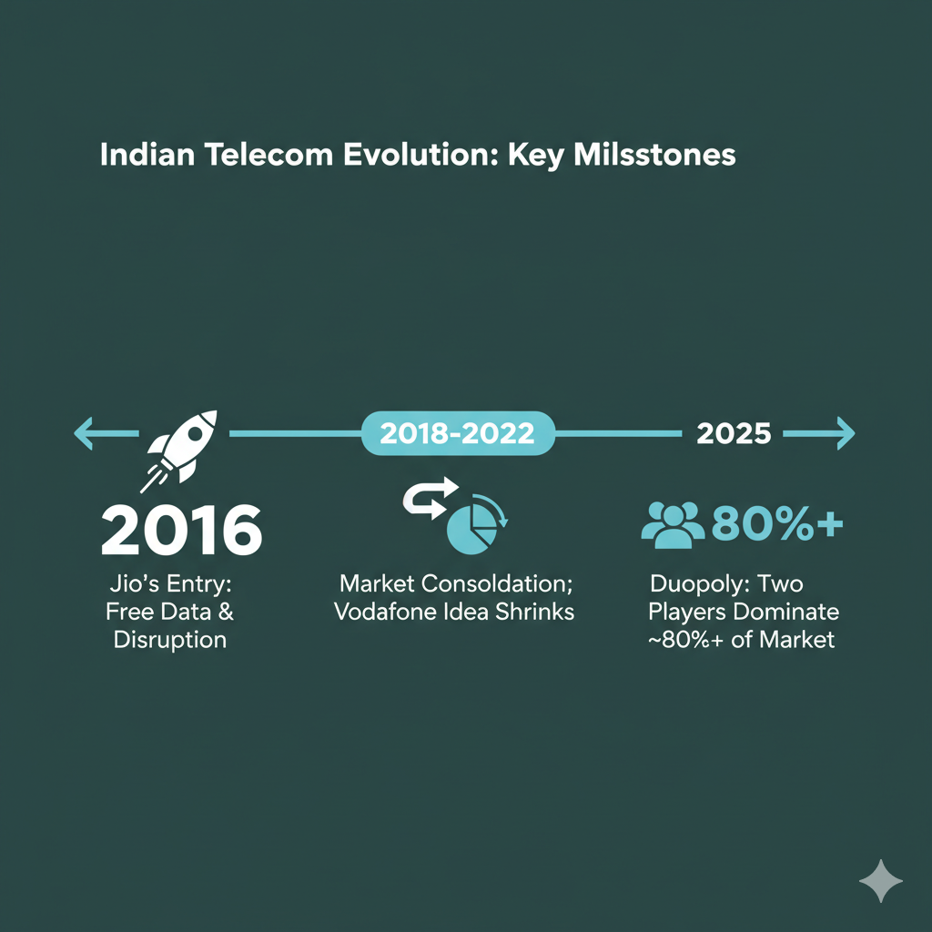
Industry Landscape
Evolution:
2016: Jio’s entry (free data, disruption)
2018–2022: Consolidation, Vodafone Idea
shrinking
2025: Duopoly → 2 players dominate ~80%+ of
market
Visual: Timeline graphic of milestones.

Slide 4
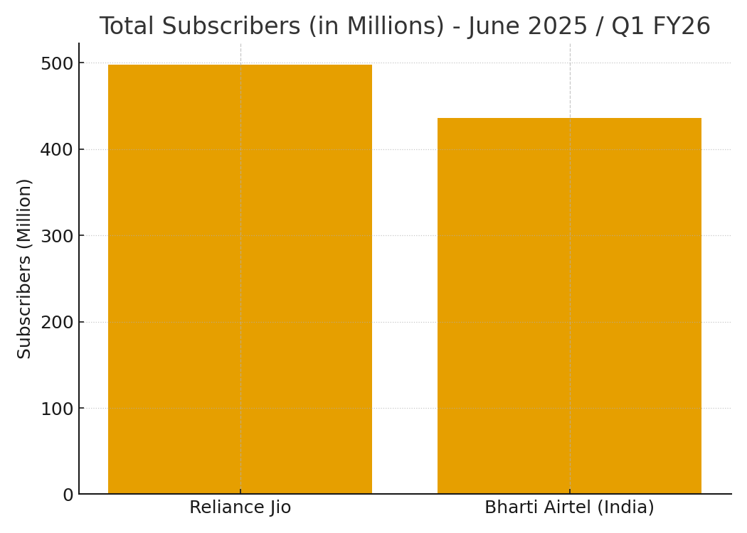
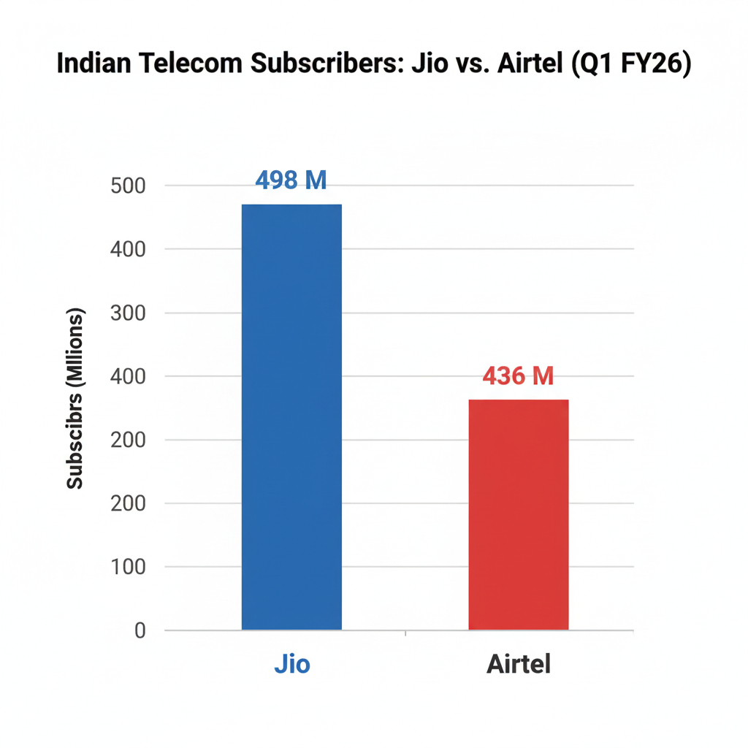
Subscriber Base (Scale)
Total Subscribers (Mn)
Jio: ~498M
Airtel: ~436M
Insight: Jio leads by ~62M, but both together hold >90% of India’s active subs

Slide 5
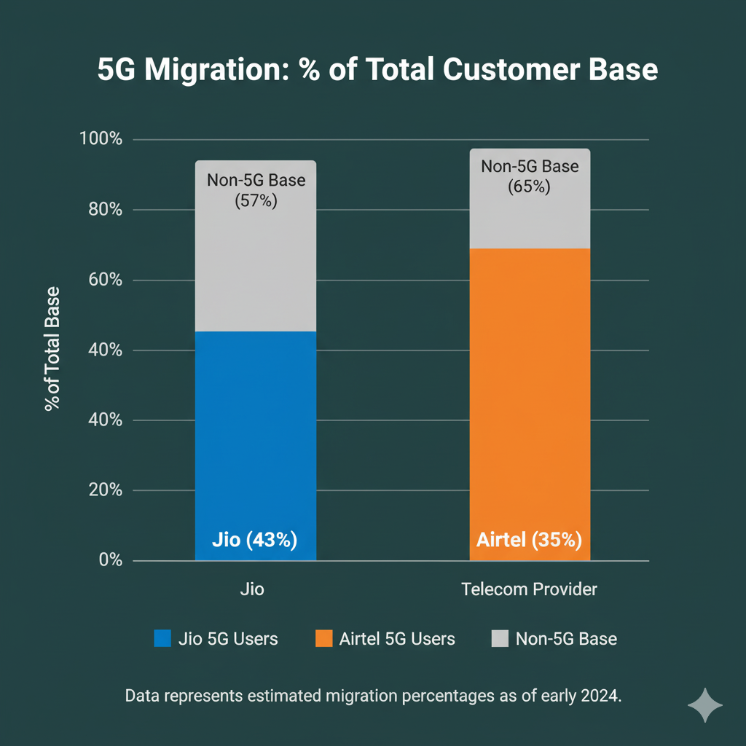
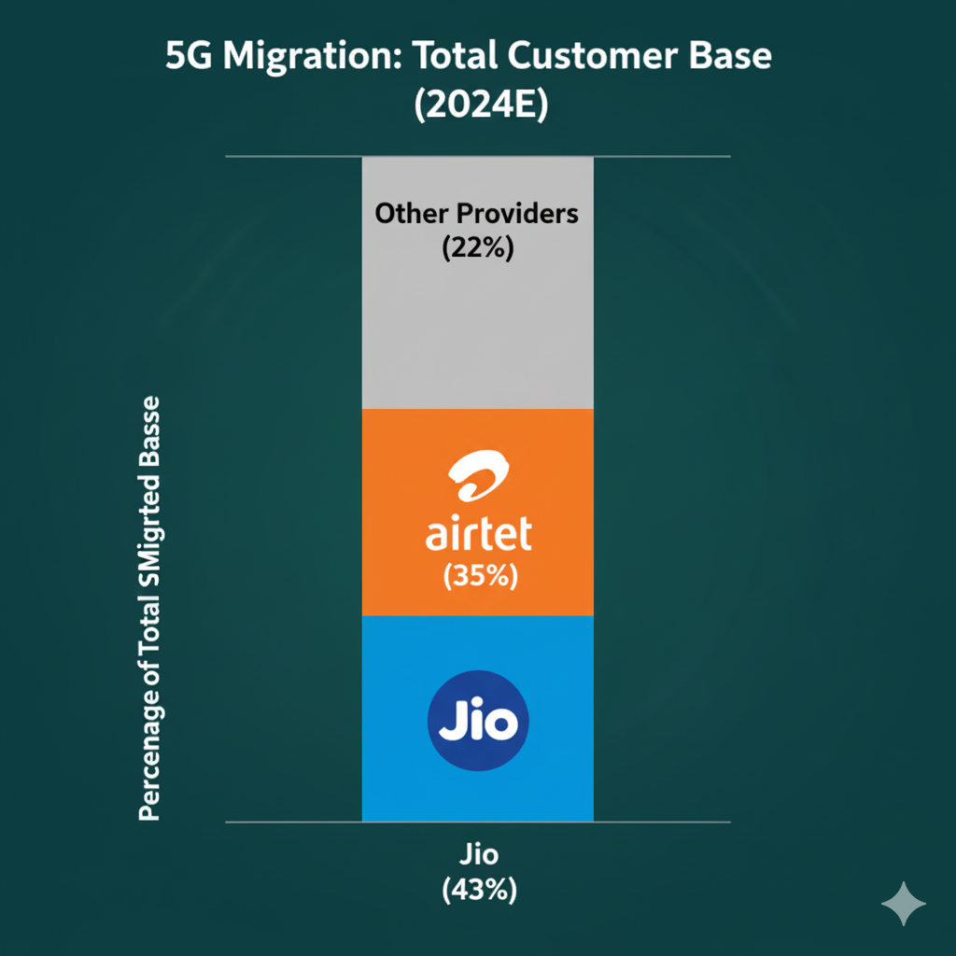
5G Adoption
5G subscribers
Jio: 213M
Airtel: 152M
% of total base migrated to 5G
Jio ~43%
Airtel ~35%
Insight: Jio is ahead in migration, giving an early edge in monetizing data-heavy services.

Slide 6

ARPU (Average Revenue Per User)
Visual: (2019–2025) — ARPU trends (₹ per user/month)
Airtel usually higher (~₹210–230) vs Jio (~₹180–190).
Insight: Airtel monetizes better → quality subs, postpaid base.

Slide 7
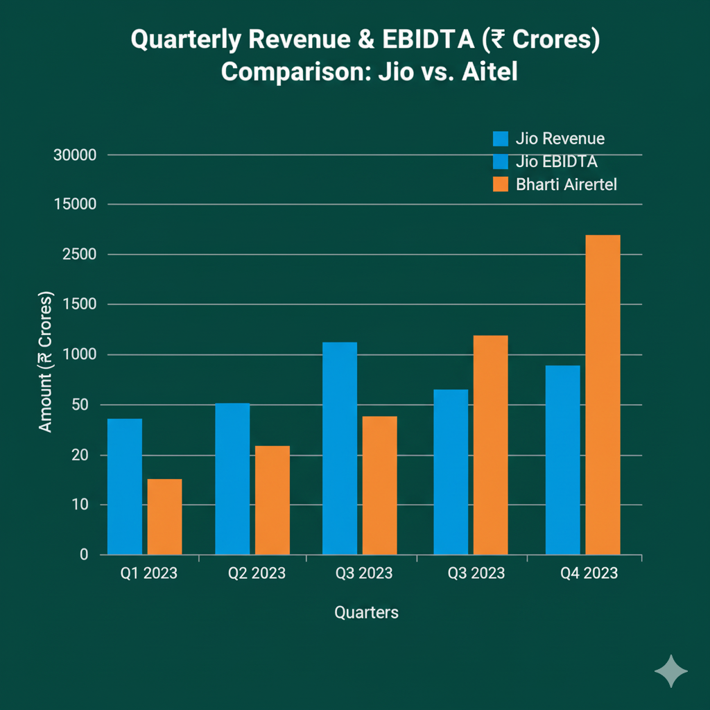
Revenue & Profitability
Chart: Quarterly Revenue / EBITDA (₹ Crores).
Insight: Jio dominates in volume, Airtel in ARPU; both highly profitable.

Slide 8

Subscriber vs. Financial Performance
Reliance Jio leads in total subscribers, but Airtel maintains its edge in key financial metrics.
Jio has a significantly larger subscriber base, a result of its disruptive entry and aggressive growth strategy.
Airtel, on the other hand, consistently generates a higher Average Revenue Per User (ARPU), indicating its success in attracting and retaining high-value customers. This focus on premium users and better monetization also translates to higher Revenue and a slightly higher Net Profit for the quarter, even with fewer subscribers.

Slide 9
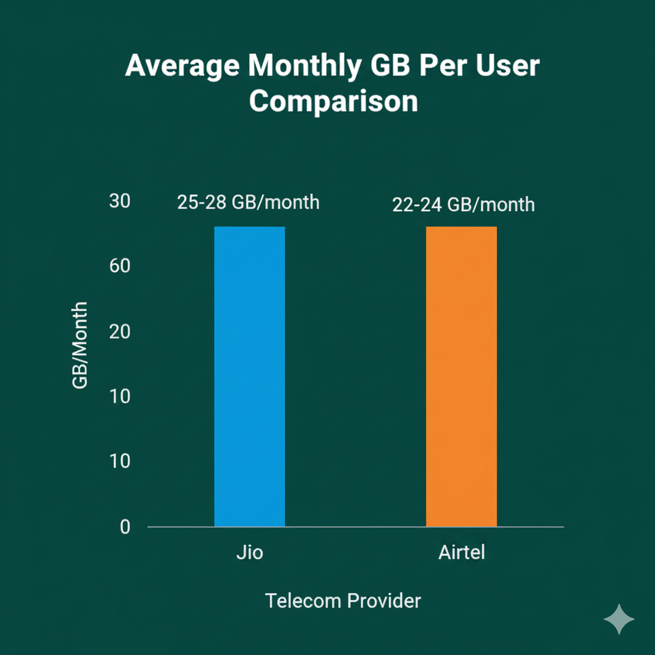
Data Usage per User
Comparison — Average monthly GB per user
Jio: ~25–28 GB/month
Airtel: ~22–24 GB/month
Insight: Jio’s pricing encourages heavier
usage; Airtel users spend more per GB.

Slide 10
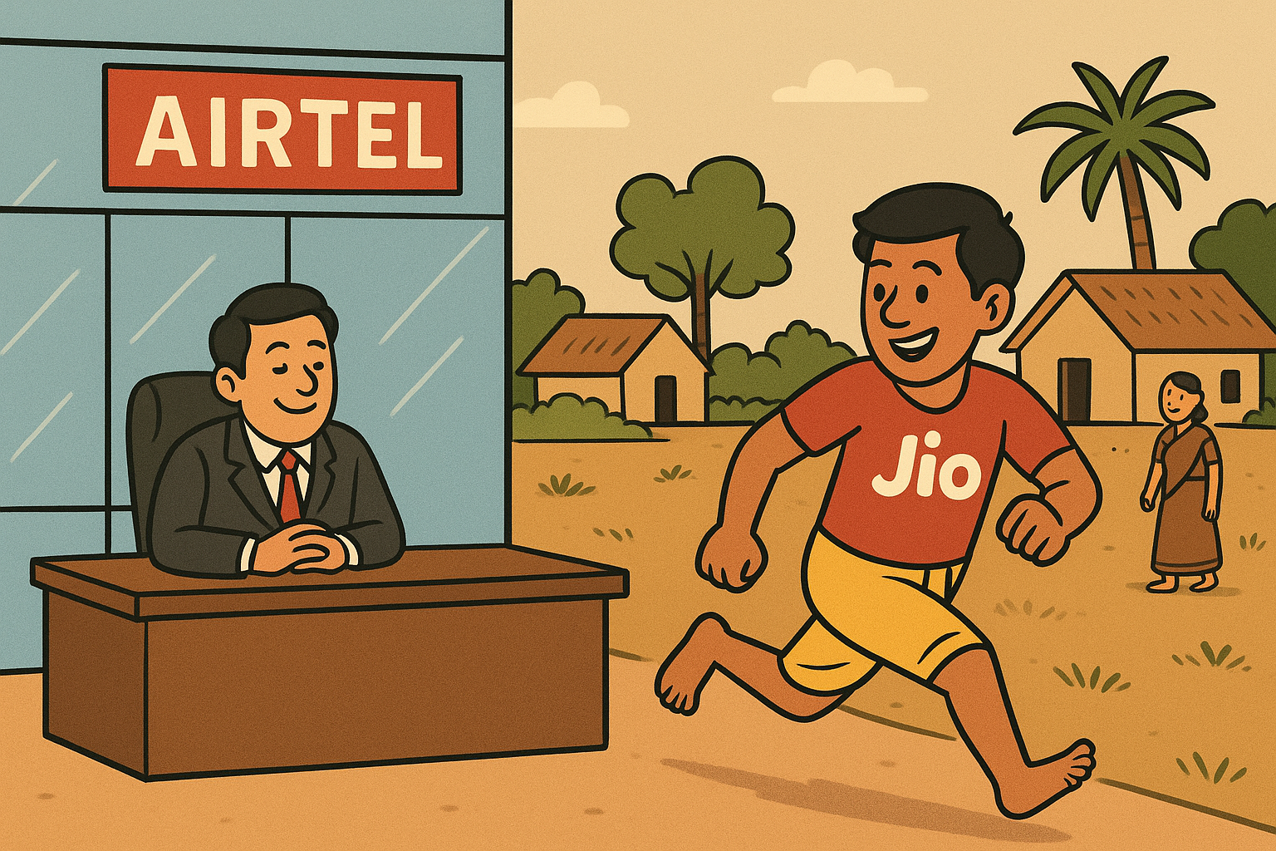
Geographical Penetration
Map of India showing:
Jio stronger in rural/semi-urban
Airtel stronger in metro/postpaid circles
Insight: Complimentary strengths → tough competition circle-wise.

Slide 11
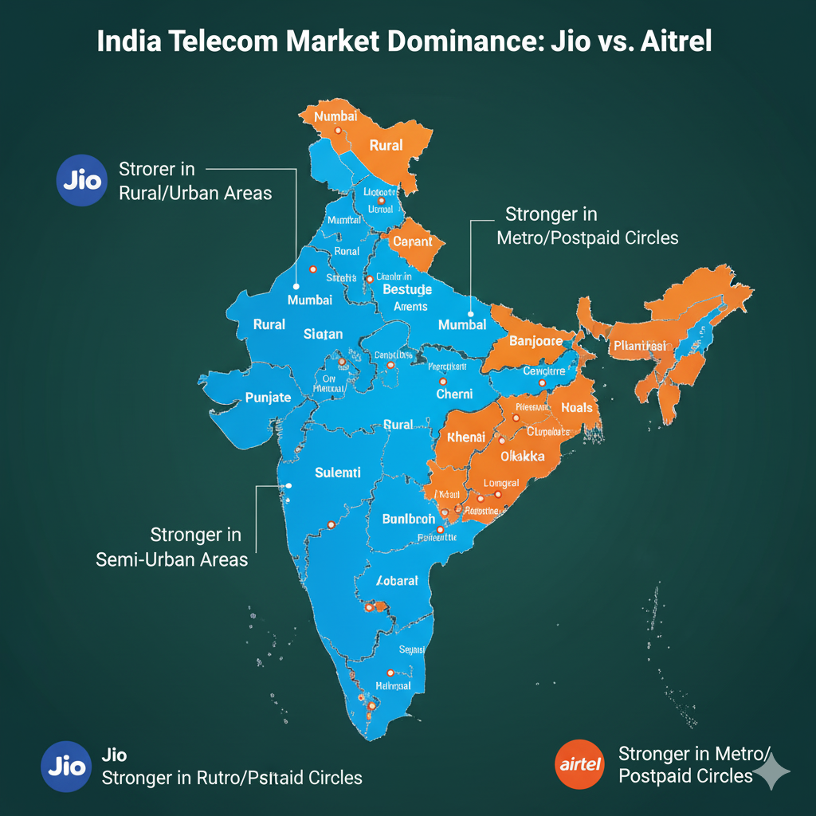
Map of India : Urban/Rural Area for (Jio & Airtel)

Slide 12

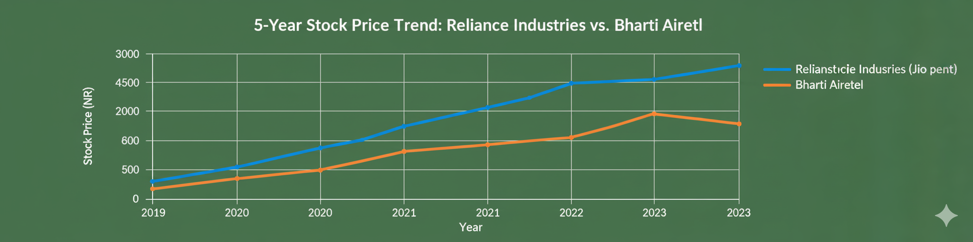
Stock Market / Investor Angle
Stock performance of Reliance vs Airtel.
f
Chart: 5-year stock price trend of Reliance Industries (Jio parent) vs Bharti Airtel.
Insight: Both stocks heavily influenced by telecom growth & 5G rollout.

Slide 13
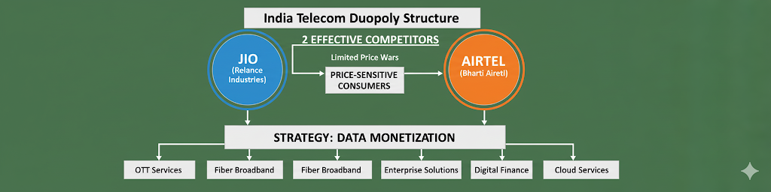
The Duopoly Explained
Visual: Duopoly structure diagram
Only 2 effective competitors, price-sensitive consumers → price wars limited, but data monetization via value-added services.
Insight: Competitive and cooperative (pricing floor, both investing in 5G infra).

Slide 14
Key Takeaways
Jio leads in scale & data adoption.
Airtel leads in ARPU & premium strategy.
Duopoly is stable, but churn mgmt is key.

Slide 15
Future Outlook
Growth levers:
5G FWA (home broadband)
Enterprise 5G solutions
Content & OTT bundles
Risks:
Regulatory, new entrant (unlikely), high spectrum costs.
Visual: Funnel or rocket infographic → future growth drivers.

Slide 16
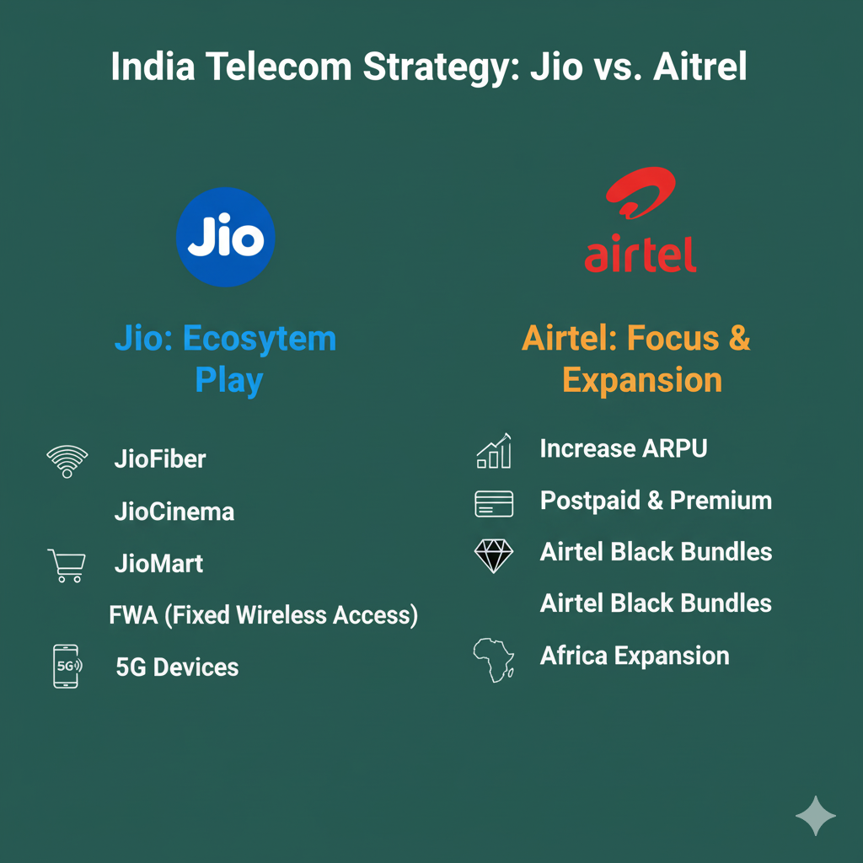
Business Strategy
Jio:
Ecosystem play: JioFiber, JioCinema,
JioMart, FWA, 5G devices.
Airtel:
Focus on ARPU, postpaid,
Airtel Black bundles, Africa expansion.
Visual: (logos + strategy icons).

Slide 17
Customer Churn Analysis and Retention Strategy in Telecom
Market Duopoly: The Indian telecom market is dominated by Jio and Airtel.
Jio leads in subscriber numbers and overall volume,
while Airtel leads in profitability and Average Revenue Per User (ARPU).
Customer Strategies:
Jio focuses on a "volume and scale" strategy, using an ecosystem of services (JioFiber, JioCinema, JioMart)
to attract and retain customers, particularly in rural and semi-urban areas.
Airtel focuses on a "premium and value" strategy, targeting high-value customers with higher ARPU and
bundled services like Airtel Black. They are stronger in urban and postpaid markets.
Churn Drivers: Key factors that cause customers to leave are network quality, confusing bills,
and poor customer service. Customers on month-to-month contracts are at a higher risk of churning.
Financials: Both companies are seeing strong revenue and EBITDA growth, driven by subscriber additions and
increased data consumption. While Jio leads in net subscriber additions, Airtel maintains a higher ARPU and superior profitability.

Slide 18
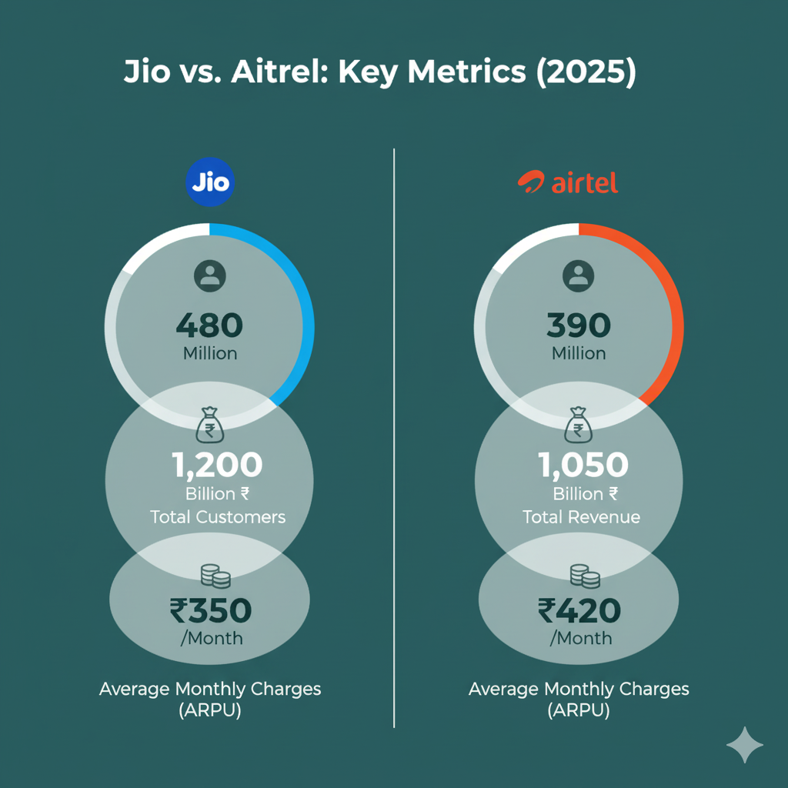
1. Start with the Hook (Context & Big Picture)
Narrative: “Our telecom customer base has grown steadily to 7,043 customers.
Revenue continues to rise,
And on the surface, things look good.”
Visual: (Total Customers, Total Revenue,
Average Monthly Charges).

Slide 19
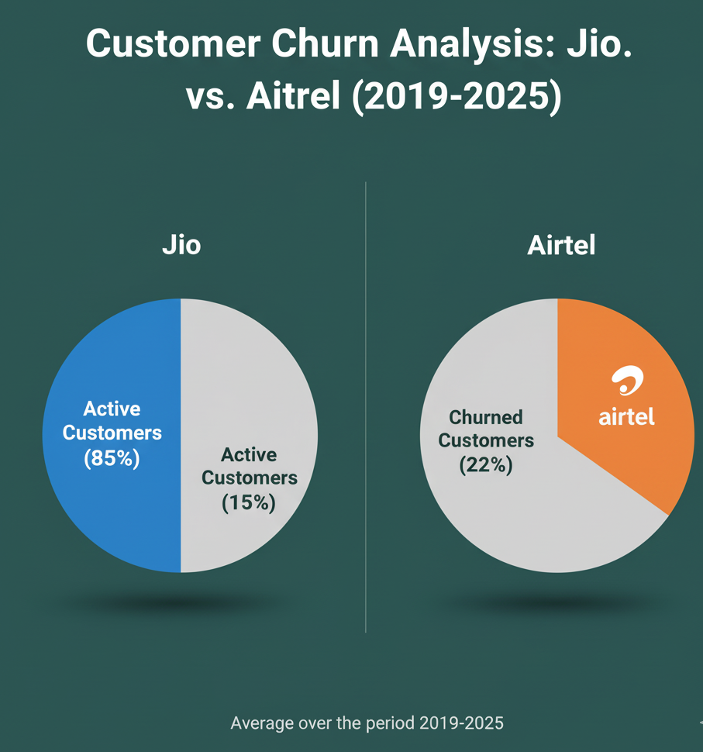
2. Present the Problem (Conflict)
Narrative: “But, churn is at 26.6% — that’s more than 1 in 4 customers leaving us.
This is a serious risk to long-term revenue.”
Visual: Active vs Churned customers.

Slide 20
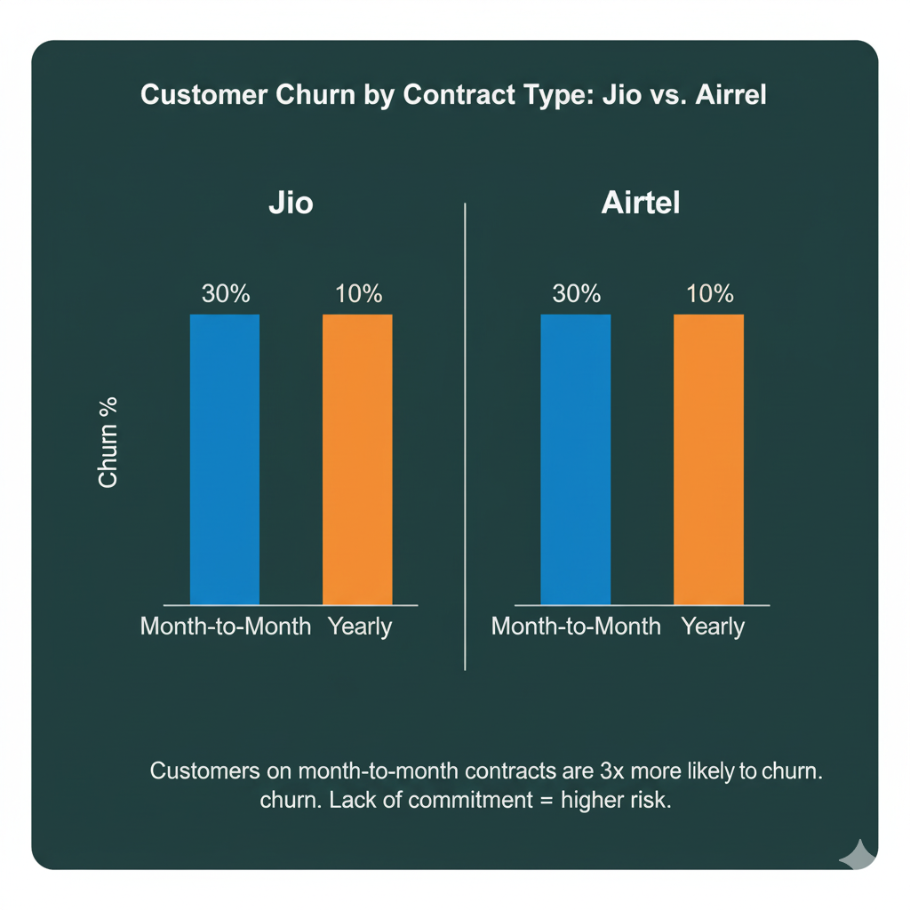
3. Deep Dive into Drivers of Churn
a) By Contract Type
Narrative: “Customers with month-to-month contracts are 3 times more likely to churn than those with yearly contracts. Lack of commitment = higher risk.”
Visual: Churn % by Contract Type.

Slide 21
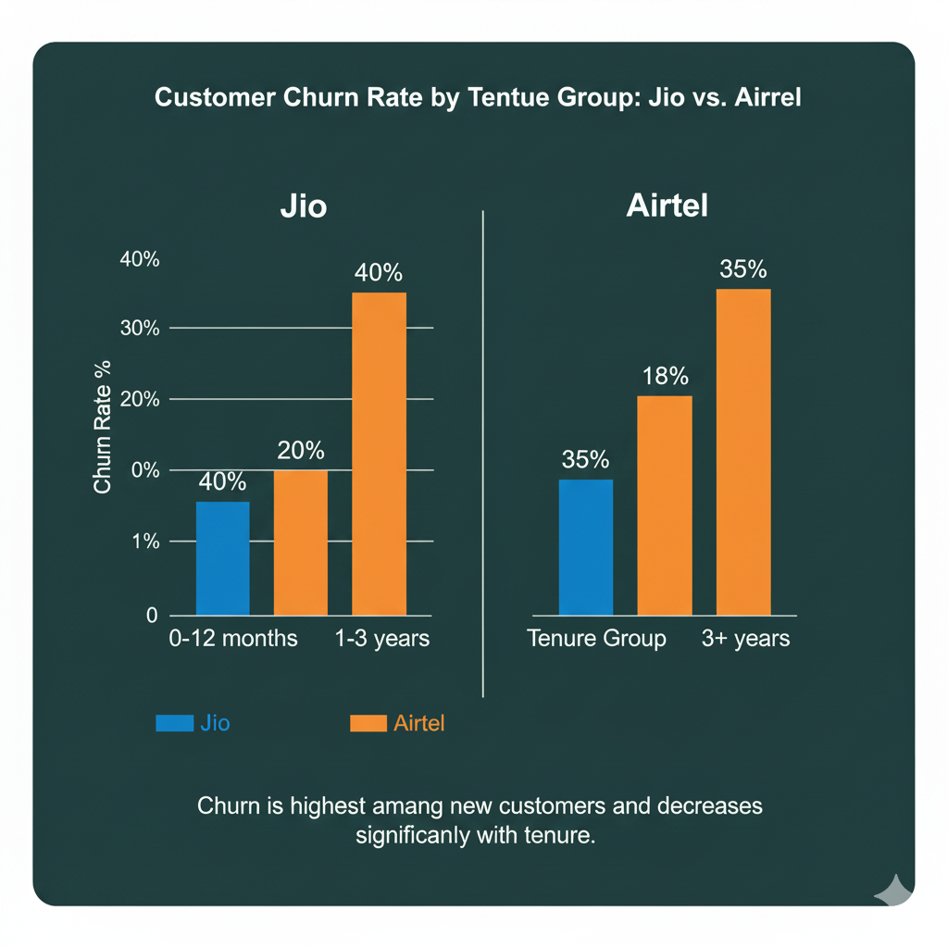
3. Deep Dive into Drivers of Churn
b) By Tenure
Narrative:
“New customers (tenure < 12 months)
churn at the highest rate.
If we don’t engage them early,
they leave before becoming loyal.”
Visual: Churn rate across tenure groups.
c) By Charges
Narrative: “Customers paying higher monthly charges are more likely to churn, possibly due to pricing dissatisfaction.”
Visual: Monthly Charges vs Churn.

Slide 22
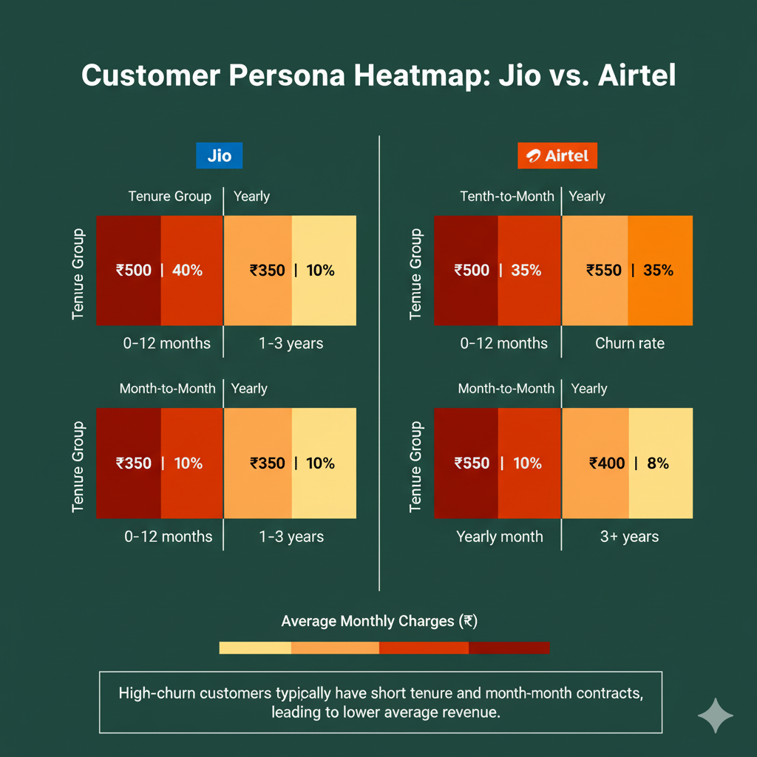
4. Highlight Key Personas (Segmentation)
Narrative: “A typical churned customer is:
Month-to-month contract
Tenure < 12 months
Monthly charges above $70 This group makes up nearly 60% of all churn.”
Visual: (Contract × Tenure × Charges).

Slide 23
5. Provide Business Recommendations (Resolution)
Narrative: “Therefore, if we:
Offer discounted annual contracts to short-tenure customers
Provide targeted retention campaigns for high-paying customers
Improve customer support for new joiners → We could reduce churn by 15–20% and save ~$5M annually.”
Visual: (Current churn vs. Projected churn after actions).
6. Close with Impact (Why It Matters)
Narrative: “This isn’t just about churn. Retaining customers is 5x cheaper than acquiring new ones.
With these actions, we secure long-term growth and customer trust.”
Visual: (Projected Retention Gain, Revenue Saved).

Slide 24
Conclusion
India’s telecom = 2-horse race.
Jio leads in scale + 5G adoption.
Airtel leads in ARPU + premium positioning.
Duopoly ensures sustainable competition → consumers benefit with quality + pricing balance.

Slide 25
Completed
Thank you

